Slide 1
Math 152 – Lesson T15
Day | Topic | Read | Homework | Additional HW
M14 | Improper Integrals | 7.8 | 1,5,13,42,68 | 2,7,18,28
M15 | Work/Average Value of a Function | 6.4 | 15,16,19,21 | 3-5,9,15,17,20,30
M16 | Work pt 2 – Avg Value of a Function | 6.5 | 7,9 | 2,16,18
Upcoming Suspenses
L15 | 25 Sept | FSPA / Quiz 3
L19 | 7 Oct | HWS #3
Notes:
Compute work done by a constant force over a constant distance
Identify when an integral is required to calculate work
Construct and compute a definite integrals representing the work done lifting objects by applying the first objective of lesson 8
Construct and compute a definite integrals representing the work done pumping liquids
Use an integral to calculate the average value of a function over a closed interval

Slide 2

Improper Review
Lemonade is drained from a cooler at a rate $r\left(t\right)=\frac{3t}{e^{t}}$ liters per hour, where $t$ is in hours. If the spigot is left open, how much lemonade will be drained from the cooler in the long run?

Slide 3

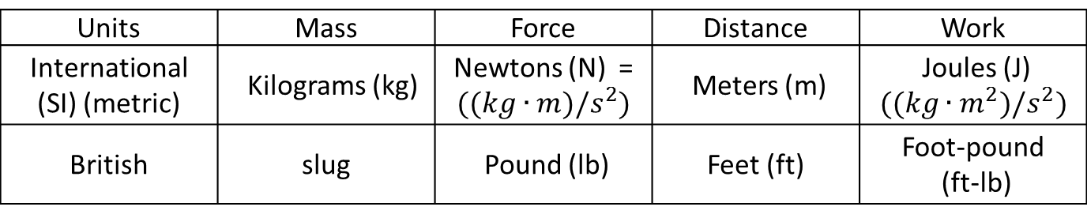
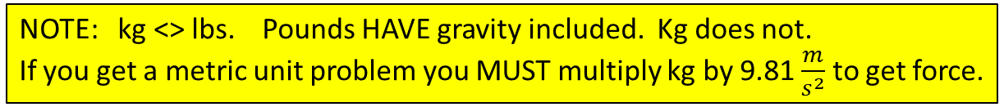

Work
$$Work=Force×Distance$$
$$Force=Mass×Acceleration$$
Units | Mass | Force | Distance | Work
International (SI) (metric) | Kilograms (kg) | Newtons (N) = $((kg∙m)/s^{2})$ | Meters (m) | Joules (J) $$((kg∙m^{2})/s^{2})$$
British | slug | Pound (lb) | Feet (ft) | Foot-pound (ft-lb)
NOTE: kg <> lbs. Pounds HAVE gravity included. Kg does not.
If you get a metric unit problem you MUST multiply kg by 9.81 $\frac{m}{s^{2}}$ to get force.
AND THIS: Draw a picture, apply coordinate system, determine slice, make it make sense
… Choose your variable and use it continuously correctly throughout the problem.

Slide 4
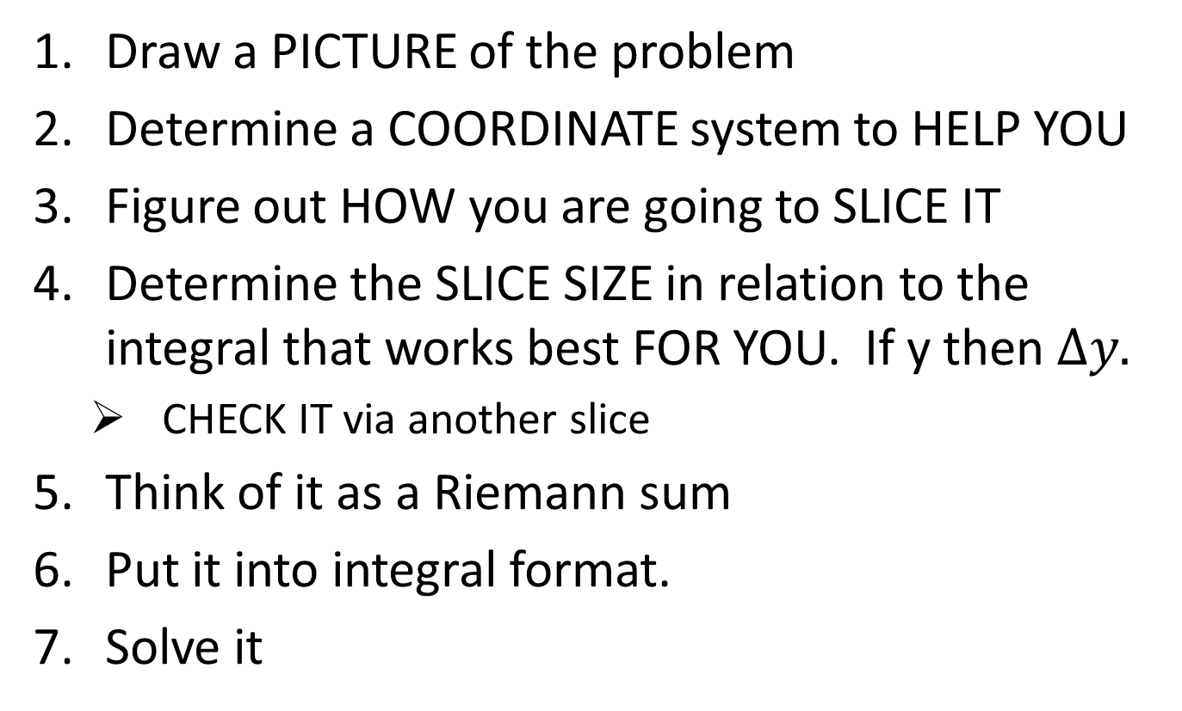
How to … set it up
Draw a PICTURE of the problem
Determine a COORDINATE system to HELP YOU
Figure out HOW you are going to SLICE IT
Determine the SLICE SIZE in relation to the integral that works best FOR YOU. If y then $∆y.$
CHECK IT via another slice
Think of it as a Riemann sum
Put it into integral format.
Solve it

Slide 5

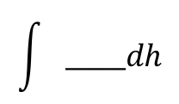
Work - Pulling
Find the work required
to lift the sandbag to a
height of 50 m
2. Find the work required
to lift the sandbag 50 m
assuming it is leaking
at a constant rate such
that the bag is empty
when it reaches the top
of the building.
2 ${kg}/m$
100 m
500 kg
Notes:
Part2: From 0 to 50, 9.8*(700-2h-1h) dh

Slide 6
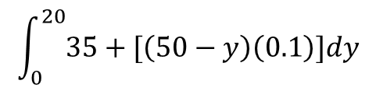
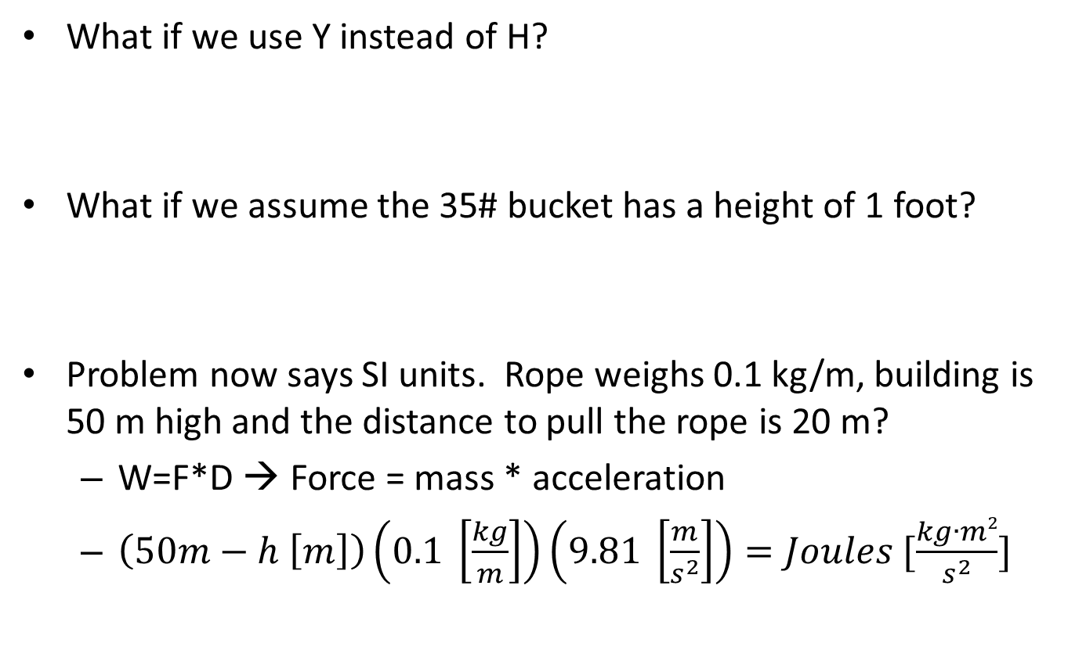
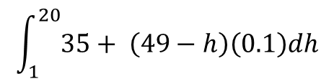
Variations - pulling problem
What if we use Y instead of H?
What if we assume the 35# bucket has a height of 1 foot?
Problem now says SI units. Rope weighs 0.1 kg/m, building is 50 m high and the distance to pull the rope is 20 m?
W=F*D → Force = mass * acceleration
$\left(50m−h \left[m\right]\right)\left(0.1 \left[\frac{kg}{m}\right]\right)\left(9.81 \left[\frac{m}{s^{2}}\right]\right)=Joules [\frac{kg∙m2}{s^{2}}]$
$$\int_{0}^{20}{35+[\left(50−y\right)\left(0.1\right)]dy}$$
$$\int_{1}^{20}{35+ \left(49−h\right)\left(0.1\right)dh}$$

Slide 7
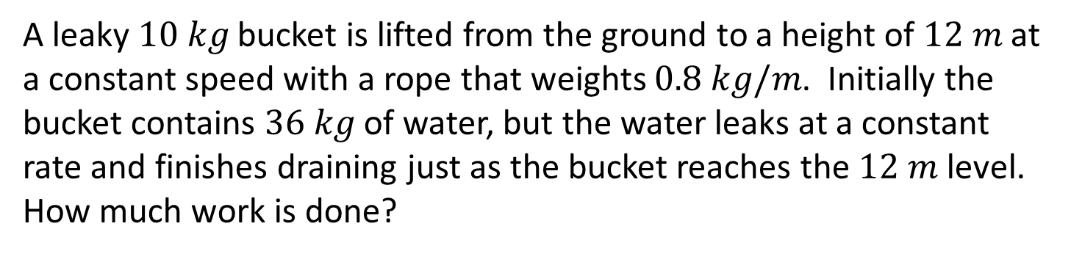
Pulling - Review
A leaky $10 kg$ bucket is lifted from the ground to a height of $12 m$ at a constant speed with a rope that weights $0.8 kg/m$. Initially the bucket contains $36 kg$ of water, but the water leaks at a constant rate and finishes draining just as the bucket reaches the $12 m$ level. How much work is done?
Notes:
Part2: From 0 to 50, 9.8*(700-2h-1h) dh

Slide 8
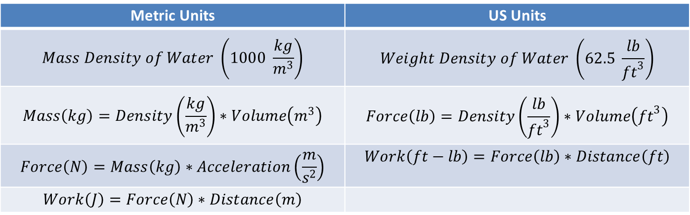
Work(Pumping)
Metric Units | US Units
$$Mass Density of Water \left(1000 \frac{kg}{m^{3}}\right)$$ | $$Weight Density of Water \left(62.5 \frac{lb}{{ft}^{3}}\right)$$
$$Mass\left(kg\right)=Density\left(\frac{kg}{m^{3}}\right)∗Volume\left(m^{3}\right)$$ | $$Force\left(lb\right)=Density\left(\frac{lb}{{ft}^{3}}\right)∗Volume\left({ft}^{3}\right)$$
$$Force\left(N\right)=Mass\left(kg\right)∗Acceleration\left(\frac{m}{s^{2}}\right)$$ | $$Work\left(ft−lb\right)=Force\left(lb\right)∗Distance\left(ft\right)$$
$$Work\left(J\right)=Force\left(N\right)∗Distance\left(m\right)$$

Slide 9
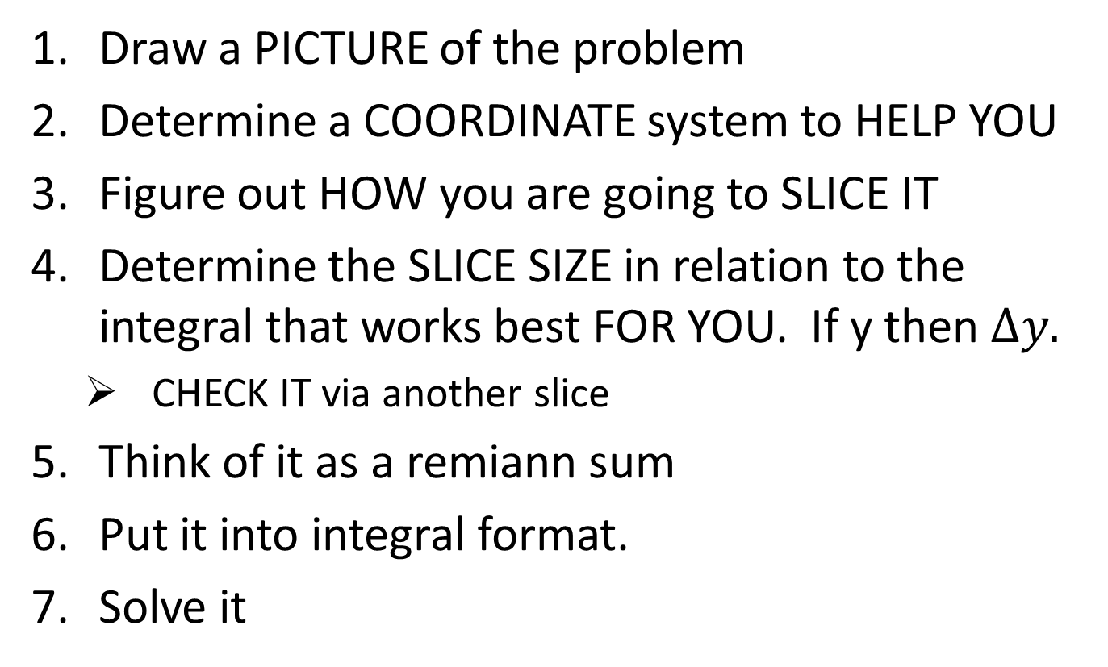
Pumping
How much work is required to pump all of the water out the top of a rectangular water tank with a length of 20 m, a width of 10 m, and a depth of 15 m? (Note: The density of water is $1000 {kg}/{m^{3}}$ . )
How much work is required to pump all of the water out the top of the water tank if the tank is half full?
Slice of water
15 m
Distance slice moves
10 m
20 m
Notes:
Work = force times distance
Force = mass times acceleration (gravity)
Mass = density times volume

Slide 10
Work - Pumping
A tank has the shape of an inverted circular cone with height 10 feet and base 4 feet. It is filled with water to a height of 8 feet. Find the work required to empty the tank by pumping al of the water out of a spout 2 feet above the top of the tank.

Slide 11
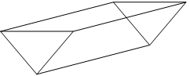
Board Work
A 200 lb cable is 100 ft long and hangs vertically from the top of a tall building. How much work is required to lift the cable to the top of the building?
A construction worker standing on a roof 30 ft off the ground pulls a 1000-lb weight to a height 10 ft off the ground using a rope which weighs 4 lb/ft. Find the work done to lift the weight.
An upright cylindrical ketchup container at a restaurant (which is half full) has a radius of 5 inches and a height of 11 inches. Given that the ketchup weighs 0.38 lb per cubic inch, how much work is required (in ft-lb) to pump the ketchup out of the nozzle (which is 3 inches above the top of the container?
The water trough below is 2 m tall, 2 m wide, and 4 m long. How much work is required to pump all of the water out of the top of the trough if the depth of the water is 70 cm? Note: The density of water is 1025 kg/m3.

